Slide 1
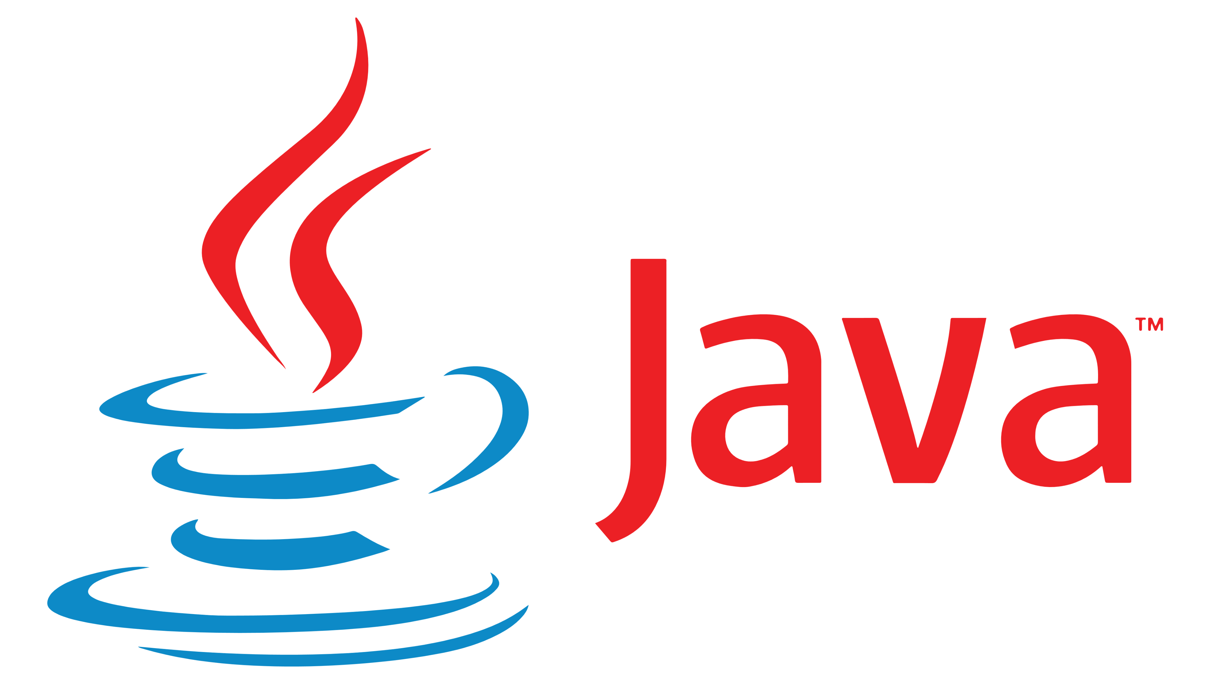
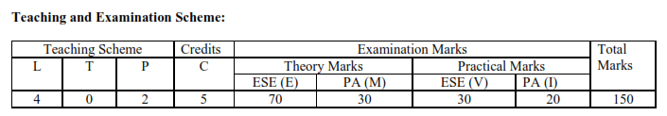
Object Oriented Programming – I
Subject Code: 3140705

Slide 2
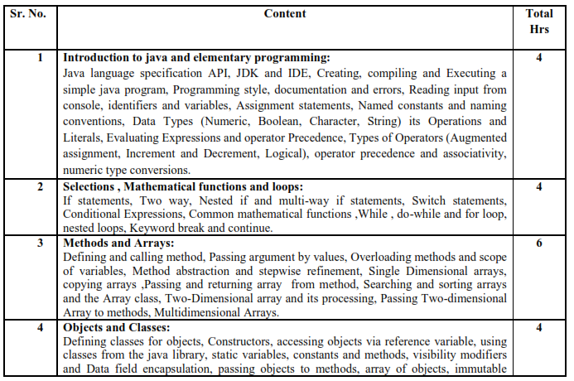
Syllabus:

Slide 3
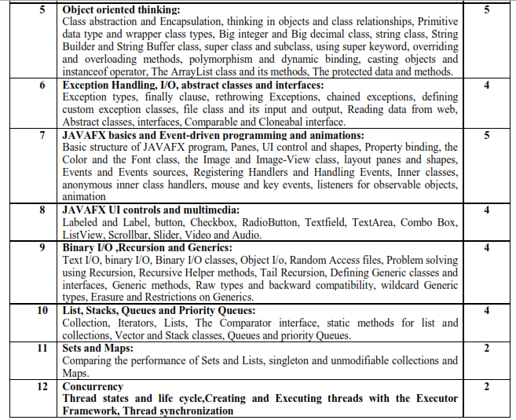
Syllabus:

Slide 4
Course Outcomes:
Describe building blocks of OOPs language
Categorize compile time and runtime errors in programs
Use collection framework in programs to optimize execution time
Develop programs using JavaFX, Thread and IO programming

Slide 5
Reference Books:
Intro to Java Programming, 10th edition, Y.Daniel Liang, Pearson
Object oriented programming with Java , Rajkumar Buyya,S Thamarai Selvi, Xingchen Chu, McGrawHill
Programming in Java, Sachin Malhotra, Saurabh Choudhary, Oxford
Programming with JAVA , E Balagurusamy, McGrawHill
CORE JAVA volume -I Cay Horstmann, Pearson

Slide 6
What is Programming?
Programming means to create or develop software, which is also called a program.
Software contains the instructions that tell a computer – or a computerized device – what to do.

Slide 7
Programming Languages
Many Programming Languages are available.
Example: C, C++, Java, .Net, Python, etc.
Each language was invented for a specific purpose:
To build on the strengths of a previous language or
To give the programmer a new and unique set of tools.
Which one is the BEST?
No “BEST” – each one has its own strengths and weaknesses.
Seasoned programmers try to master as many different programming languages as they can.

Slide 8
Programming Languages
Machine Language
Set of built-in primitive instructions – binary code.
Add two numbers – binary code would be like: 1101101010011010.
Writing programs in machine language is tedious process.
Very difficult to read and modify.
Machine dependent.

Slide 9
Programming Languages
Assembly Language – low-level language
Alternative to machine language.
Use mnemonic – short-descriptive word for each machine-language instructions like add, sub, etc.
To add the numbers 2 and 3 and get the result, assembly code would be like: add 2, 3, result
Makes programming easier than machine language.
Still tedious to write code.
Knowledge of how CPU works is required.
Machine dependent.

Slide 10
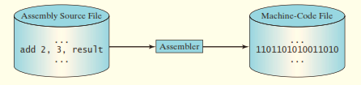
Programming Languages
Assembly Language – low-level language
Requires another program – called an assembler, to translate assembly-language programs into machine code.

Slide 11
Programming Languages
High Level Language
English-like and easy to learn and use.
Instructions are called statements.
High-level language statement that computes the area of a circle with a radius 5 would look like: area = 5 * 5 * 3.14159;
Platform independent.
Program is called a source program or source code.
Requires another programming tool – interpreter or a compiler, to translate source programs into machine code.

Slide 12

Programming Languages
Interpreter
Reads one statement from the source code, translates it to machine code and then executes it right away.
Statement from the source code may be translated into several machine instructions.

Slide 13
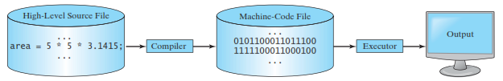
Programming Languages
Compiler
Translates the entire source ode into a machine-code file, and the machine-code file is then executed.

Slide 14
Java Programming Language
Powerful and versatile programming language for developing software running on mobile, desktop computers and servers.
Developed by a team led by James Gosling at Sun Microsystems.
Sun Microsystems was purchased by Oracle in 2010.
Originally called Oak, Java was designed in 1991 for use in embedded chips in consumer electronic appliances.
In 1995, Renamed Java, and redesigned for developing Web applications.

Slide 15
Java Programming Language
Characteristics of Java:
Simple
Object oriented
Distributed
Interpreted
Robust
Secure
Architecture neutral
Portable
High performance
Multi-threaded
Dynamic

Slide 16
Java Programming Language
Applications of Java:
Develop robust-mission critical applications.
Develop Web Applications.
Develop applications on Web Servers.
Develop standalone applications on desktop computers and mobile devices.
Software for Android phones is developed using Java.

Slide 17
Java Language Specification, API, JDK and IDE
Java Language Specification – Defines Java Syntax
Java API – Defines Java Library
JDK – software for developing and running Java programs.
Java IDE – integrated development environment for rapidly developing Java programs.

Slide 18
Java Language Specification, API, JDK and IDE
Computer languages have strict rules of usage.
Computer will not understand the programs if not written following this rules.
Java Language Specification and Java API defines the Java Standards.
Java Language Specification is a technical definition of the Java Programming language’s syntax and semantics.
Complete Java Language Specification:
http://docs.oracle.com/javase/specs/.

Slide 19
Java Language Specification, API, JDK and IDE
Application Program Interface (API), also know as library, contains predefined classes and interfaces for developing Java Programs.
Latest version of API:
http://dowonload.java.net/jdk8/docs/api/.

Slide 20
Java Language Specification, API, JDK and IDE
Java comes with 3 editions:
Java SE
Client-side application – standalone or applets running from Web browser.
Java EE
Server-side applications – Java servlets, JSP, JSF.
Java ME
Applications for mobile devices.

Slide 21
Java Language Specification, API, JDK and IDE
We will use Java SE – foundation upon which all other Java Technology is based.
Many version of Java SE: latest version Java SE 8.
Oracle release each version with a Java Development Kit (JDK).
For Java SE 8 – JDK 1.8 (Java 8 or JDK 8).

Slide 22
Java Language Specification, API, JDK and IDE
JDK contains set of programs, each invoked from a command line, for developing and testing Java programs.
We can use Java Development Tools (e.g. NetBeans, Eclipse and TextPad) – software that provides an IDE for developing Java programs.

Slide 23
First Java Program
Every Java program must have at least one class.
Each class has a name.
In this example, the class name is Welcome.
By convention, class names start with an uppercase letter.
// This program prints Welcome to Java!
public class Welcome {
public static void main(String[] args) {
System.out.println("Welcome to Java!");
}
}
Output : Welcome to Java !

Slide 24
First Java Program
Line 2 defines the main method.
In order to run a class, the class must contain a method named main.
The program is executed from the main method.
// This program prints Welcome to Java!
public class Welcome {
public static void main(String[] args) {
System.out.println("Welcome to Java!");
}
}
Output : Welcome to Java !

Slide 25
First Java Program
A statement represents an action or a sequence of actions.
The statement System.out.println("Welcome to Java!") in the program will display the greeting "Welcome to Java!" on the console.
// This program prints Welcome to Java!
public class Welcome {
public static void main(String[] args) {
System.out.println("Welcome to Java!");
}
}
Output : Welcome to Java !

Slide 26
First Java Program
A statement represents an action or a sequence of actions.
The statement System.out.println("Welcome to Java!") in the program will display the greeting "Welcome to Java!" on the console.
// This program prints Welcome to Java!
public class Welcome {
public static void main(String[] args) {
System.out.println("Welcome to Java!");
}
}
Output : Welcome to Java !

Slide 27
First Java Program
Every statement in Java terminates with a semicolon (;).
// This program prints Welcome to Java!
public class Welcome {
public static void main(String[] args) {
System.out.println("Welcome to Java!");
}
}
Output : Welcome to Java !

Slide 28
First Java Program
Reserved words or keywords are words that have a specific meaning to the compiler and cannot be used for other purposes in the program.
For example, when the compiler sees the word class, it understands that the word after class is the name for the class.
// This program prints Welcome to Java!
public class Welcome {
public static void main(String[] args) {
System.out.println("Welcome to Java!");
}
}
Output : Welcome to Java !

Slide 29
First Java Program
A pair of braces in a program forms a block that groups components of a program.
// This program prints Welcome to Java!
public class Welcome {
public static void main(String[] args) {
System.out.println("Welcome to Java!");
}
}
Method Block
Class Block
Output : Welcome to Java !

Slide 30
First Java Program
Why main method is defined this way?
Why System.out.println( … ) is used to display a message on the console?
Questions will be answered in subsequent discussions.

Slide 31
More Java Programs
public class Welcome {
public static void main(String[ ] args) {
System.out.println(“Programming is fun !”);
System.out.println(“Fundamentals first”);
System.out.println(“Problem Driven”);
}
}
Output : Programming is fun !
Fundamentals first
Problem Driven

Slide 32
More Java Programs
public class Welcome {
public static void main(String[ ] args) {
System.out.println((10.5 + 2 * 3) / (45 – 3.5));
}
}
Output : 0.39759036144578314

Slide 33
Creating, Compiling and Executing a Java Program
Creating a Java Program:
Save Java program in a .java file.
Text editor – Notepad, Notepad++.
IDE – Netbeans or Eclipse.
Source file must end with the extension .java and must have the same exact name as the public class name.
Ex: Welcome.java.
public class Welcome {
public static void main(String[ ] args) {
//Display message Welcome to Java ! on the console
System.out.println(“Welcome to Java !”);
}
}

Slide 34
Creating, Compiling and Executing a Java Program
Compiling a Java Program:
Compile it into a .class file.
JDK – We will use JDK 8. Latest version is JDK 15.
Ex: javac Welcome.java

Slide 35
Creating, Compiling and Executing a Java Program
Compiling a Java Program:
The Java architectures is divided into two major parts –
The Java compiler and
The Java runtime (also known as VM or JVM).
The compiler part
Since Java has to run on many platforms with same compiled code, the compiler cannot generate machine or platform dependent output (or binary exe files).
So, if a Java program is compiled on Windows, and user wants to run it on Linux say, then the Java compiler cannot compile the Java program in the same way a C program is compiled. That would only run on Windows.
So, Java compiler generates a bytecode file which is a kind of machine language that only a Java VM can understand.

Slide 36
Creating, Compiling and Executing a Java Program
Compiling a Java Program:
The interpreter (so called) part
Java VM reads the bytecode and execute the instructions (remember that the compiler is same for all platforms, while the interpreter is platform specific).
The VM does conversion of bytecode int machine code by using a interpreter.
In most cases a one-to-one mapping – does not generally require the complexities of a full fledged compiler.
Of course, now Java VM has improved a lot and with the introduction of Java Hotspot compilers and JIT, things are much more complex.

Slide 37
Creating, Compiling and Executing a Java Program
Executing a Java Program:
JVM first loads the bytecode of the class to memory using a program called the class loader.
Class loader dynamically loads all the classes used in the program just before they are needed.
Next, JVM uses a program called the bytecode verifier to check the validity of the bytecode + ensure that the bytecode does not violate Java’s security restrictions.
Finally, JVM uses JIT compiler which helps improve the performance of Java programs by compiling bytecodes into native machine code at run time.

Slide 38
Creating, Compiling and Executing a Java Program
Executing a Java Program:
Command to Run Java Program:
java Welcome

Slide 39
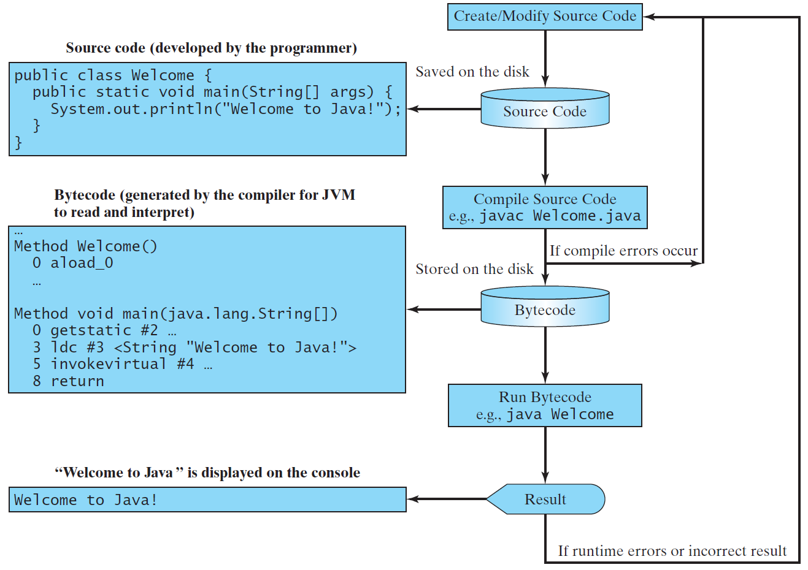
Creating, Compiling and Executing a Java Program

Slide 40
Programming Style and Documentation
Programming Styles – what programs look like.
Bad programming style – hard to read the program.
Documentation – body of explanatory remarks and comments pertaining to a program.
Good programming style and proper documentation – easy to read and help programmers prevent errors.

Slide 41
Programming Style and Documentation
Appropriate Comments and Comment Styles:
Include a summary at the beginning of the program
What the program does
Its key features
Its supporting data structures and
Any unique techniques it uses.
Include your name, class section, instructor, date, and a brief description at the beginning of the program.

Slide 42
Programming Style and Documentation
Appropriate Comments and Comment Styles:
Single line Comment
Preceded by two slashes(//) on a line.
Ex: //This application program displays Welcome to Java !
Block or Paragraph Comment
Enclosed between /* and */ on one or several lines.
Ex 1: /* This application program displays Welcome to Java ! */
Ex 2: /* This application program
displays Welcome to Java ! */

Slide 43
Programming Style and Documentation
Appropriate Comments and Comment Styles:
Javadoc Comments
Begin with /** and end with */.
Can be extracted into an HTML file using the JDK’s javadoc command.
Used for commenting on an entire class or an entire method.

Slide 44
Programming Style and Documentation
Naming Conventions
Choose meaningful and descriptive names.
Class names:
Capitalize the first letter of each word in the name.
For example, the class name ComputeExpression.

Slide 45
Programming Style and Documentation
Proper Indentation and Spacing
Makes programs clear and easy to read.
Indent each subcomponent or statement at least two spaces more than the construct within which it is nested.
Single space should be added on both sides of a binary operator
Ex: System.out.println(3+4*4);
System.out.println(3 + 4 * 4);
Bad Style
Good Style

Slide 46
Programming Style and Documentation
Block Styles
Two popular styles:
Next-line style
End-of-line style
public class Test
{
public static void main(String[ ] args)
{
System.out.println(“Block Styles !”);
}
}
public class Test {
public static void main(String[ ] args) {
System.out.println(“Block Styles !”);
}
}

Slide 47
Programming Errors
Syntax Errors
Detected by the compiler
Runtime Errors
Causes the program to abort
Logic Errors
Produces incorrect result

Slide 48
Programming Errors
Examples:
public class ShowSyntaxErrors {
public static main(String[] args) {
System.out.println("Welcome to Java);
}
}
public class ShowRuntimeErrors {
public static void main(String[] args) {
System.out.println(1 / 0);
}
}
public class ShowLogicErrors {
public static void main(String[] args) {
System.out.println("Celsius 35 is Fahrenheit degree ");
System.out.println((9 / 5) * 35 + 32);
}
}

Slide 49
Programming Errors
Common Errors
Missing Braces
public class Welcome {
………
}

Slide 50
Programming Errors
Common Errors
Missing Semicolons
public static void main(String[] args){
System.out.println("Programming is fun !");
System.out.println("Fundamentals First");
System.out.println("Problem Driven")
}

Slide 51
Programming Errors
Common Errors
Missing Quotation Marks
public class Test{
public static void Main(string[] args){
System.out.println("Problem Driven );
}

Slide 52
Programming Errors
Common Errors
Misspelling Names
public class Test{
public static void Main(string[] args){
System.out.println((10.5 + 2 * 3) / (45 – 3.5));
}

Slide 53
Any Questions?

